Slide 1
[Account Manager] Tools
Basic Tools and Supply Chain
Notes:
Main Title Page

Slide 2
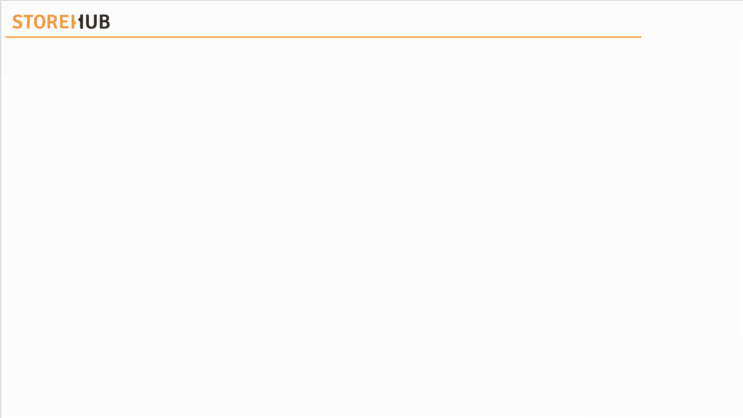



| Mechanism
Overview
Tools
Supply Chain

Slide 3
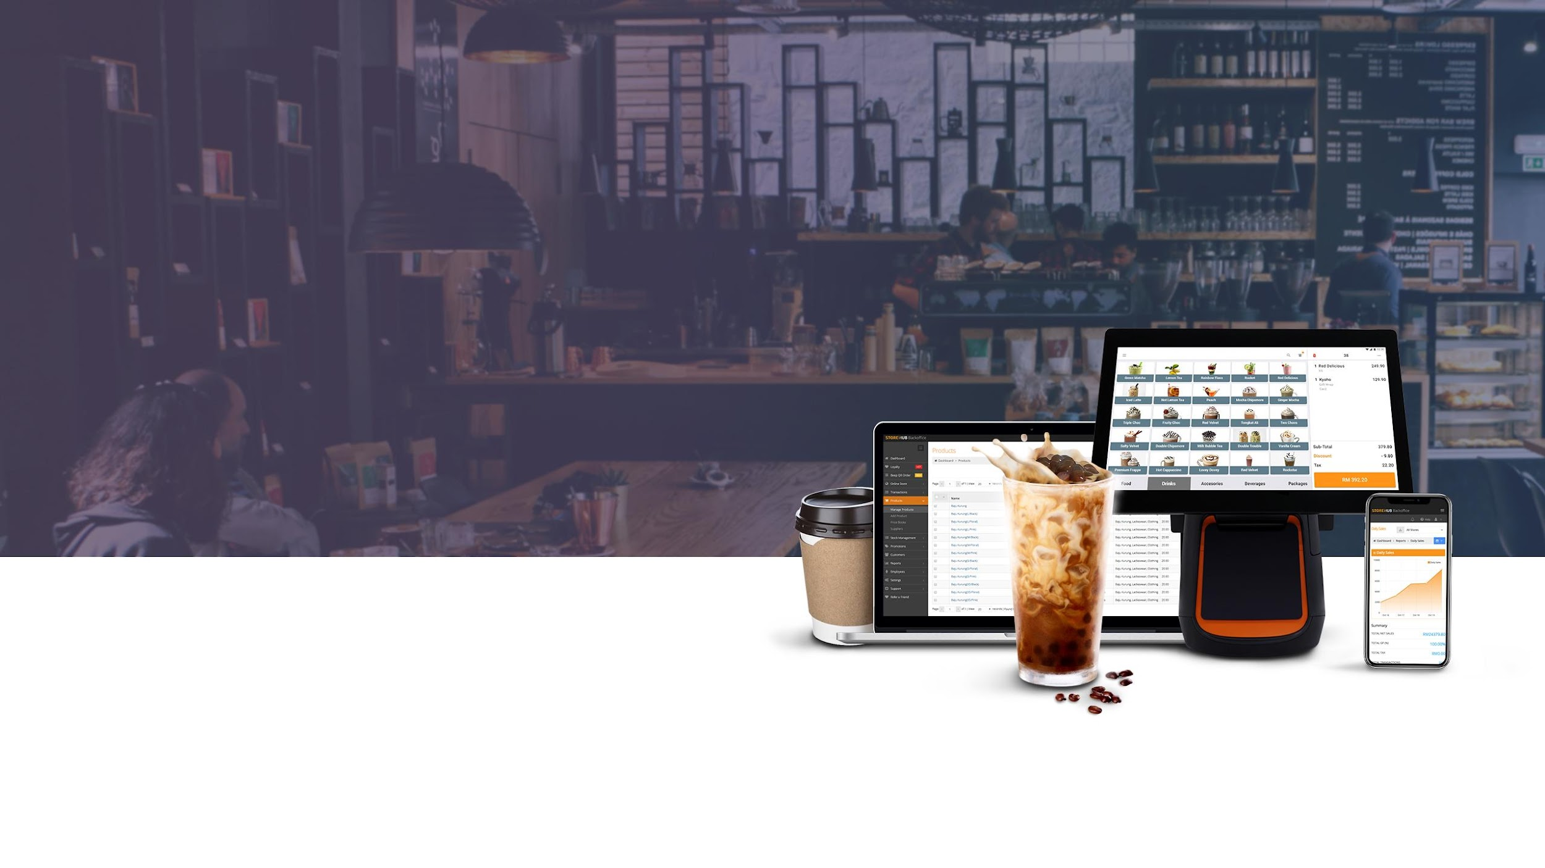
Tools

Slide 4








| Mechanism
Main Tools
Internal
KB
Library
Internal
Support
Tool
Aircall

Slide 5

[ Team Using : All ]

Slide 6
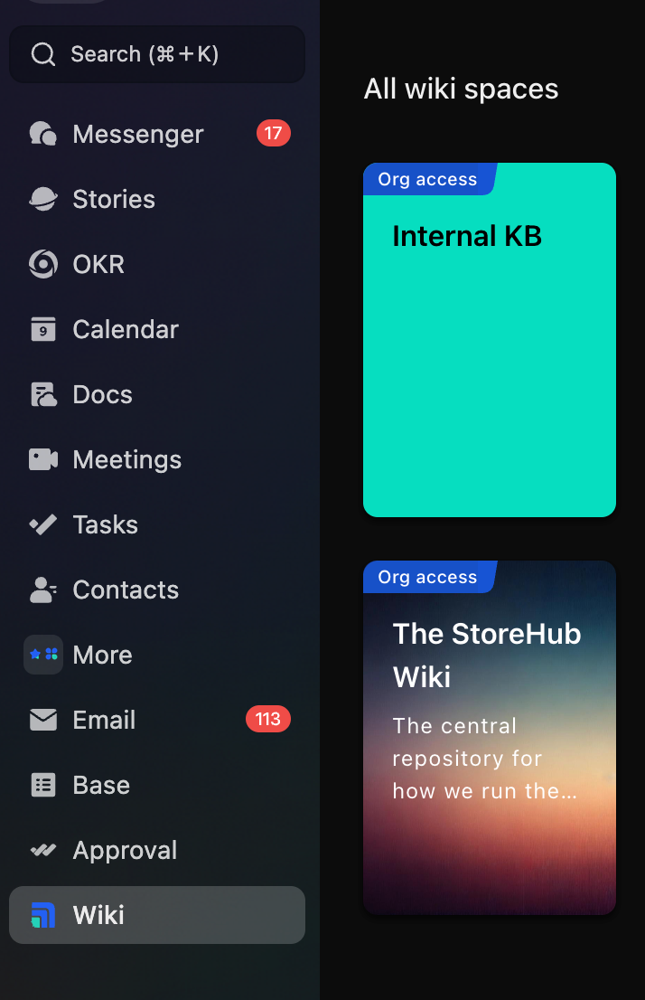
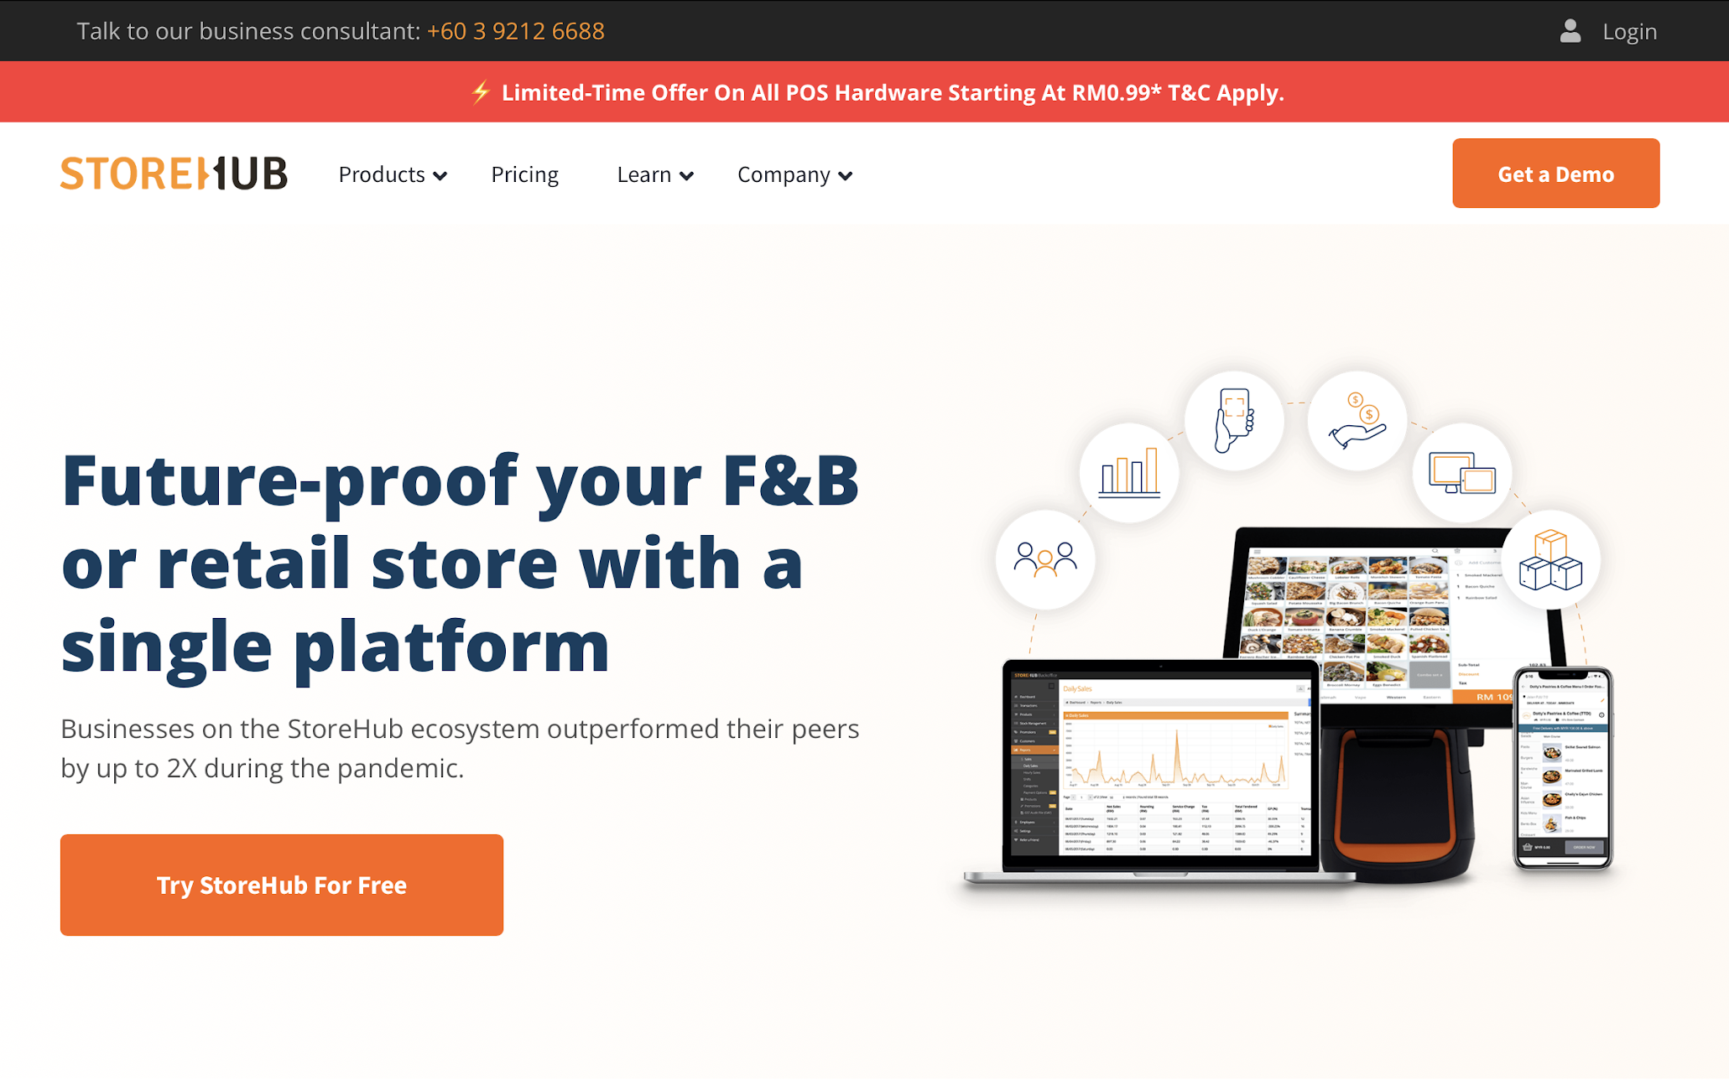
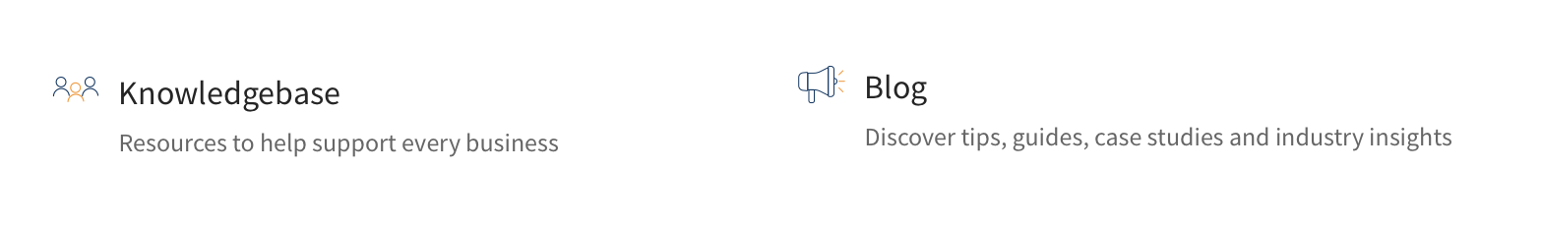
Knowledge Base
Introduction
Internal KB Library
Available at https://www.storehub.com/
Available at Lark Wiki
KB = Knowledge Base

Slide 7
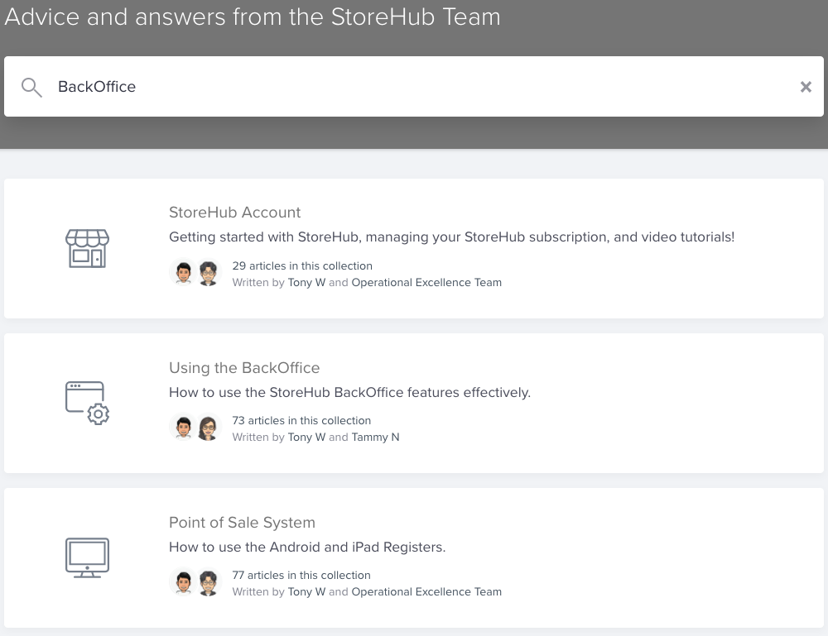
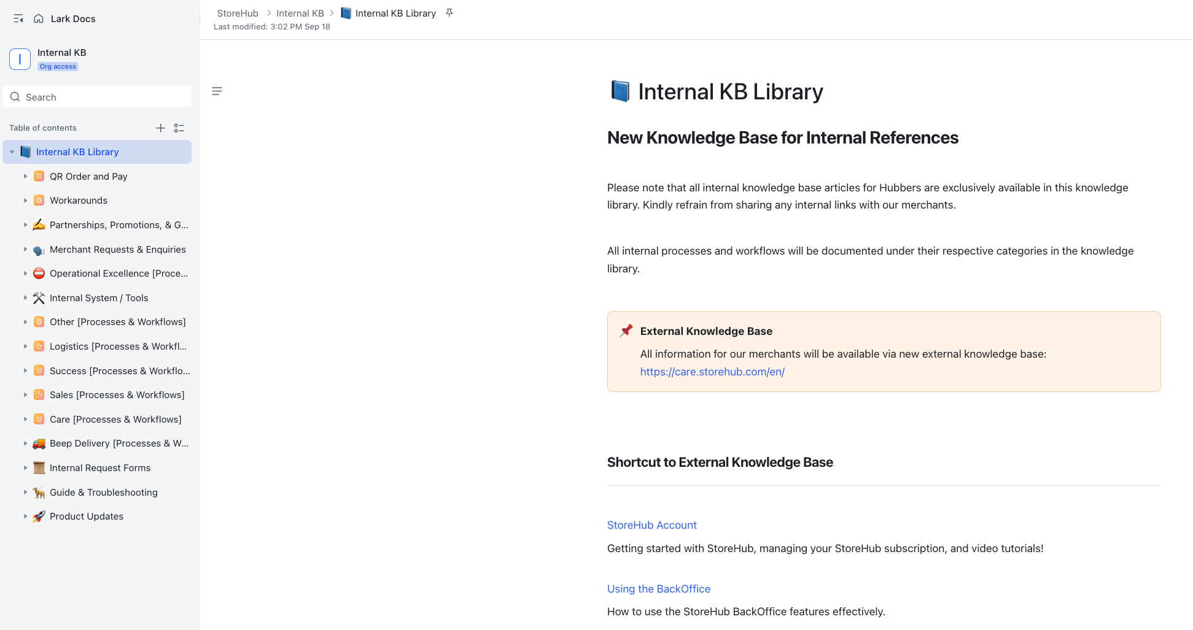
Knowledge Base
Navigation
Internal KB Library
Search Box
Search Box
Categories
Categories
KB = Knowledge Base

Slide 8
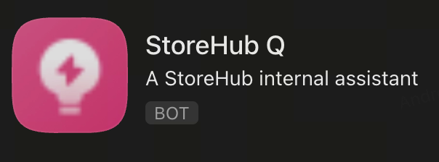
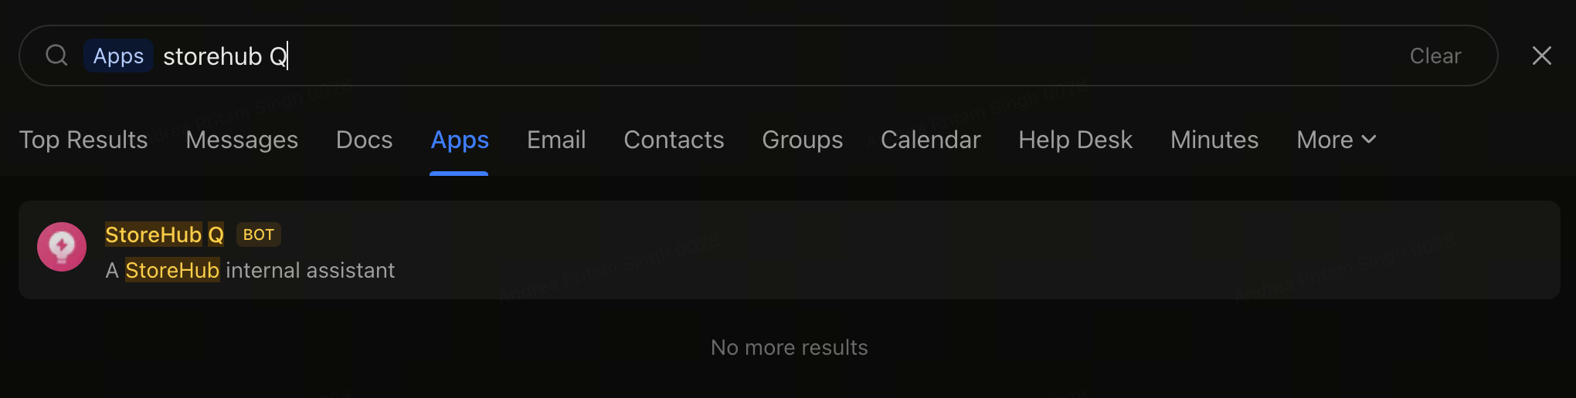
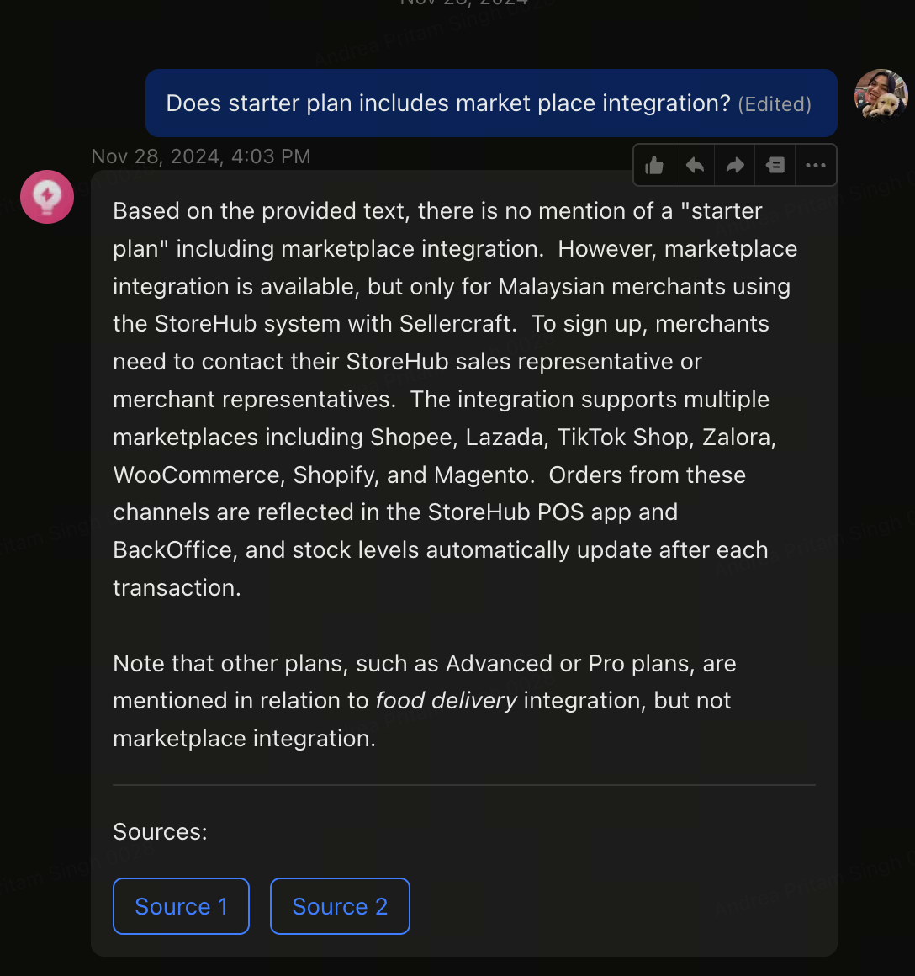
Knowledge Base
Navigation
Search for StoreHub Q on Lark
Have a question about StoreHub? Just ask StoreHub Q for answers!
What is StoreHub Q?
StoreHub Q is an AI-powered assistant designed to gather information from StoreHub’s resources, helping you provide accurate and efficient answers.
KB = Knowledge Base

Slide 9

IST – Internal Support Tool
[ Team Using : Beep / Fleet / Care/ Onboarding/ Success ]
Notes:
Change slide

Slide 10

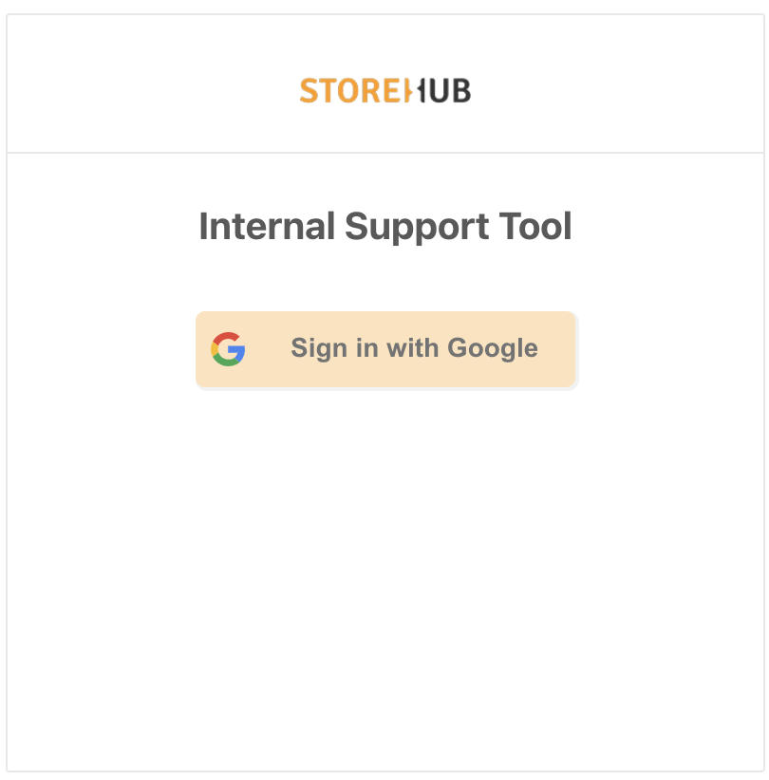

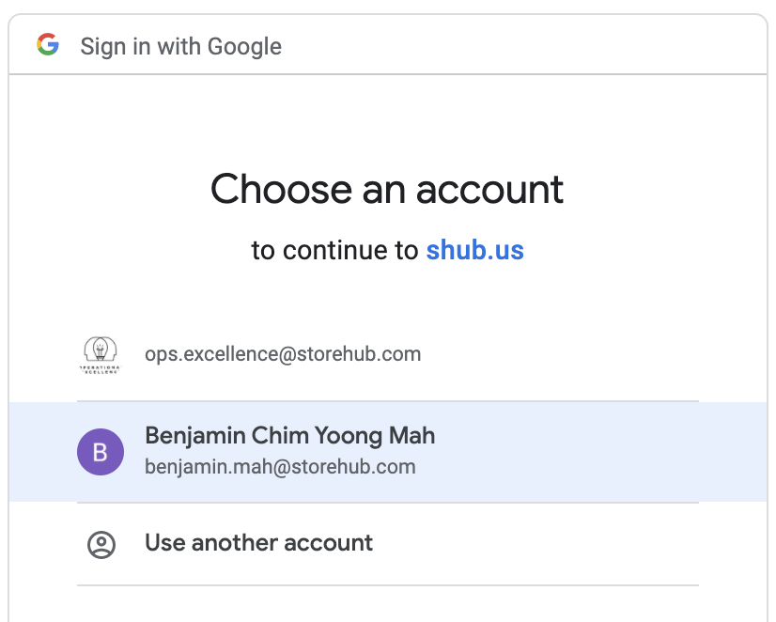
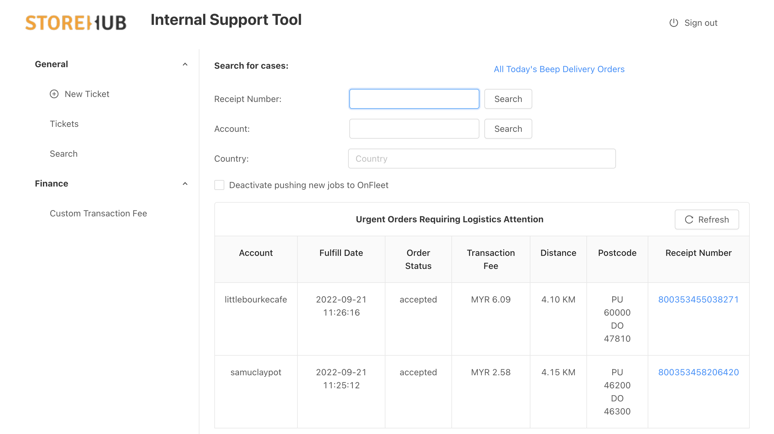
IST – Internal Support Tool
Internal
Support
Tool
Introduction
Functions
Links:
https://internal.shub.us/logistics/dashboard
Create Temp. Employee Access
Locating Beep orders
Payout adjustment
Sending vouchers
Mainly used by:
Beep Team
Logistics Team
Care Team

Slide 11
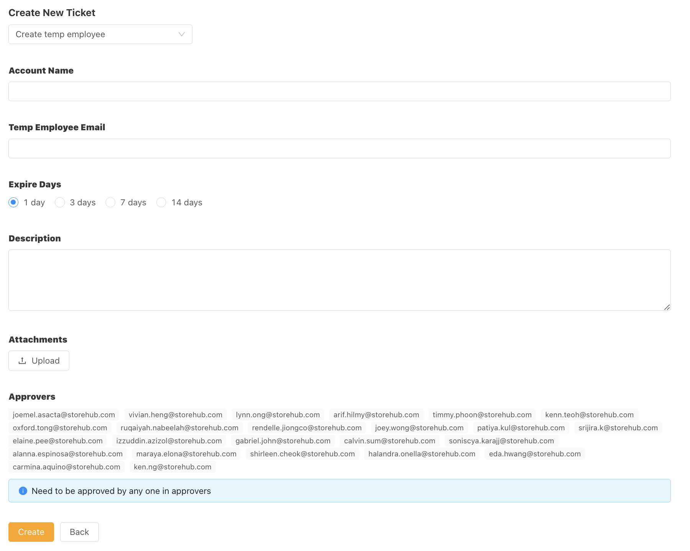
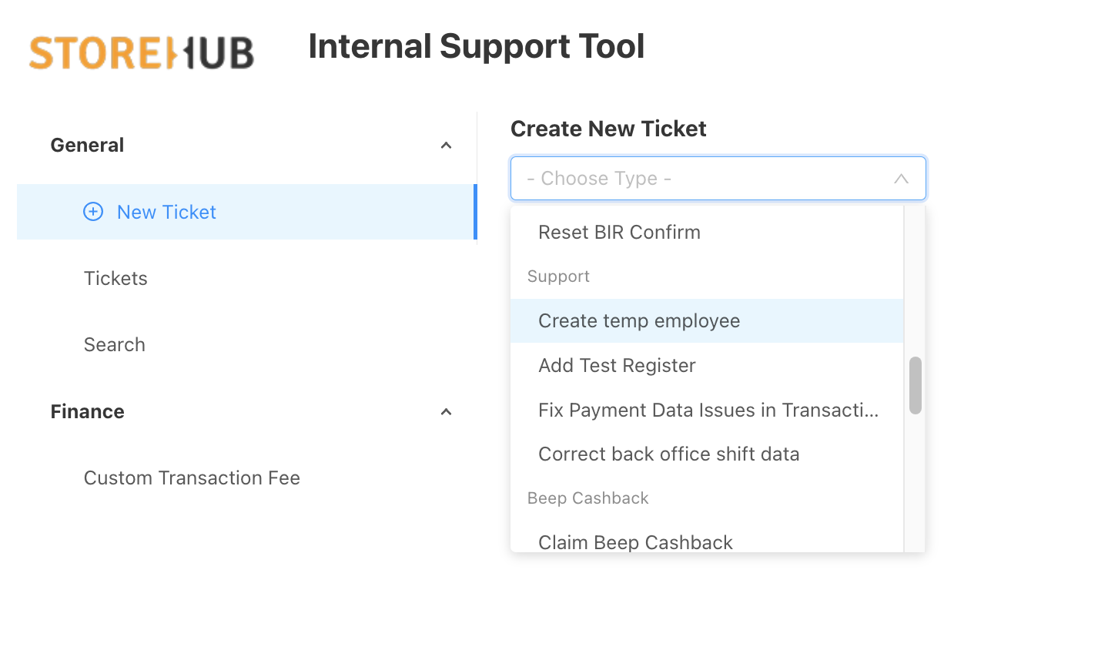
IST – Internal Support Tool
Internal
Support
Tool
Temporary Employee Access
Temporary BackOffice access is required in case the merchant requires assistance to adjust some setup or troubleshoot as necessary.
Notes:
803907798012155

Slide 12
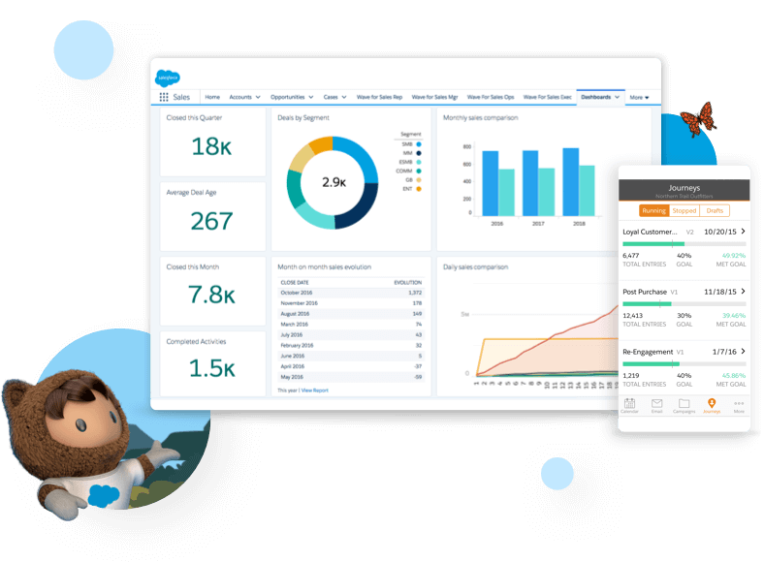

Salesforce
[ Team Using : Sales/Success/Care ]

Slide 13
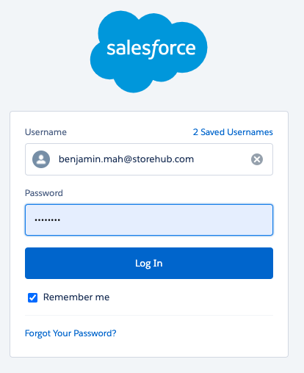
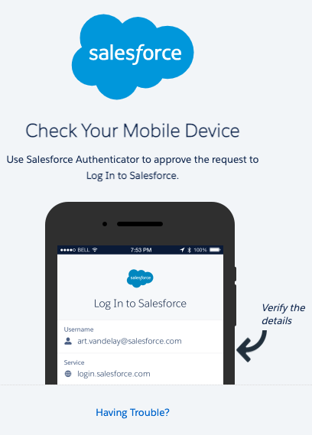
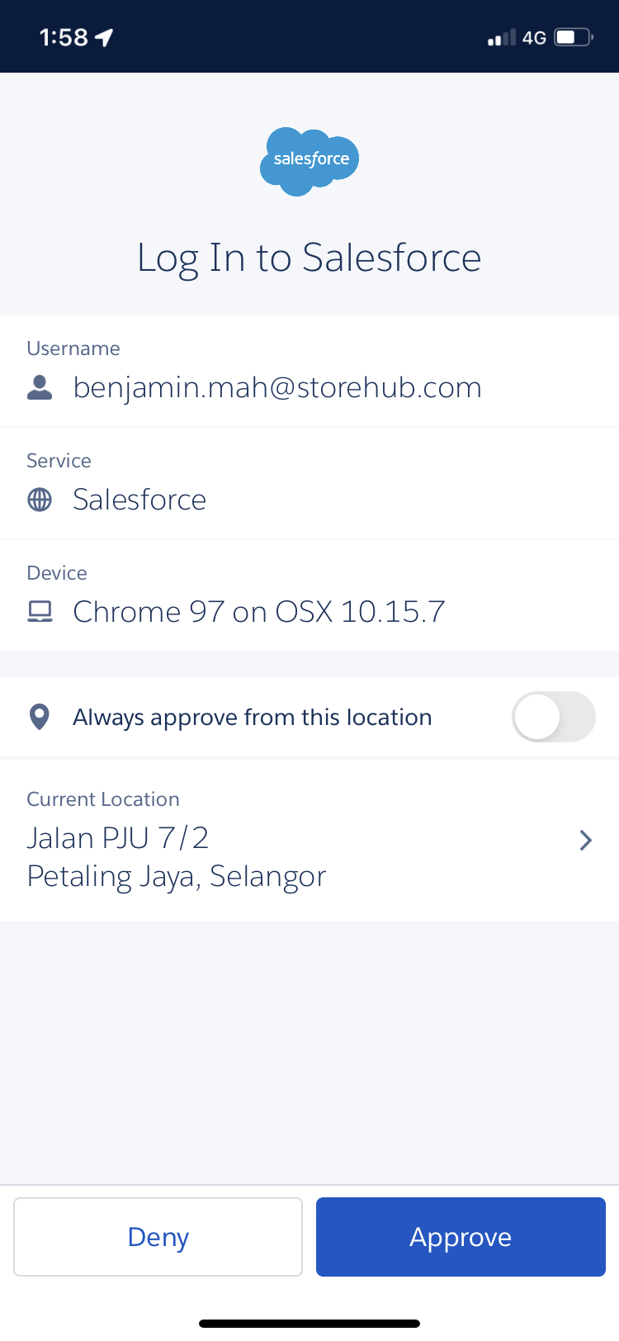
Salesforce
Login
https://storehub.my.salesforce.com/
Verify authentication by downloading Salesforce Authenticator app
Click approve on Authenticator app

Slide 14
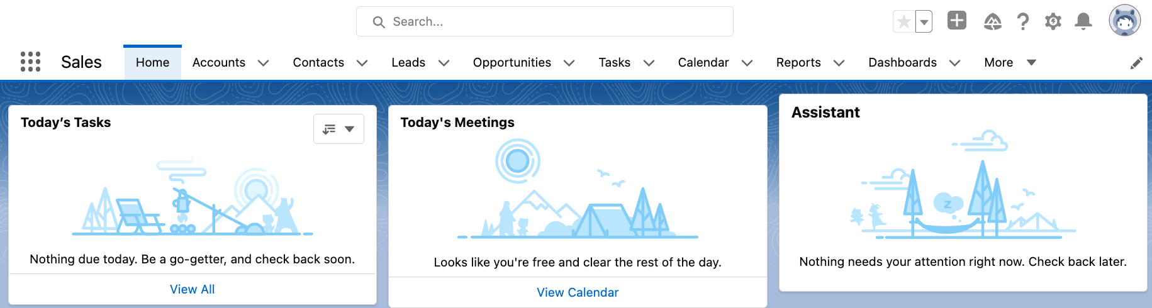
Salesforce
Introduction
Intro
Function
Used by
Managing merchant’s StoreHub journey
Lead > Won > Onboarding
Qualifying leads
Merchant’s information
Onboarding schedule
Hardware tracking
Sales Team
Success Team
Care Team

Slide 15
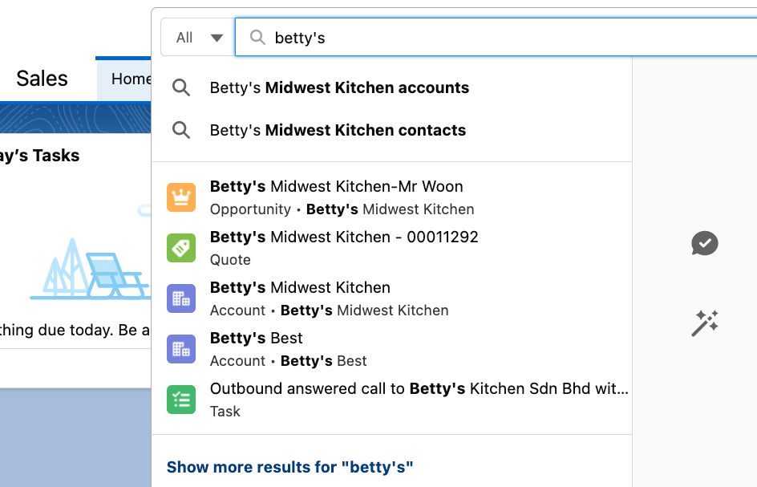
Salesforce
Navigation (cont.)
Search Input :
Account name
Email
PIC
Select Salesforce Objects:
Lead - New Lead (Qualified/Unqualified)
Opportunity - Meeting Completed by BC (Won/Lost)
Account - Overview of merchant’s Account Details
Contact - Merchant’s Contact Info
PIC = Person in Charge

Slide 16
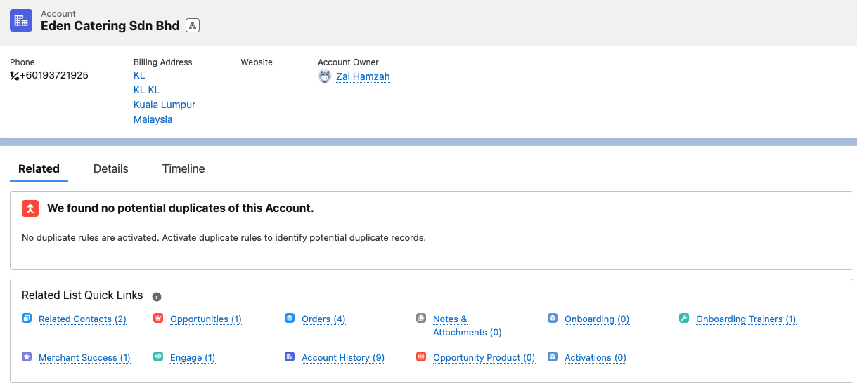
Salesforce
Navigation (Account)
Contact details
Opportunities can be found under Account
Onboarding Pipeline
PIC = Person in Charge

Slide 17
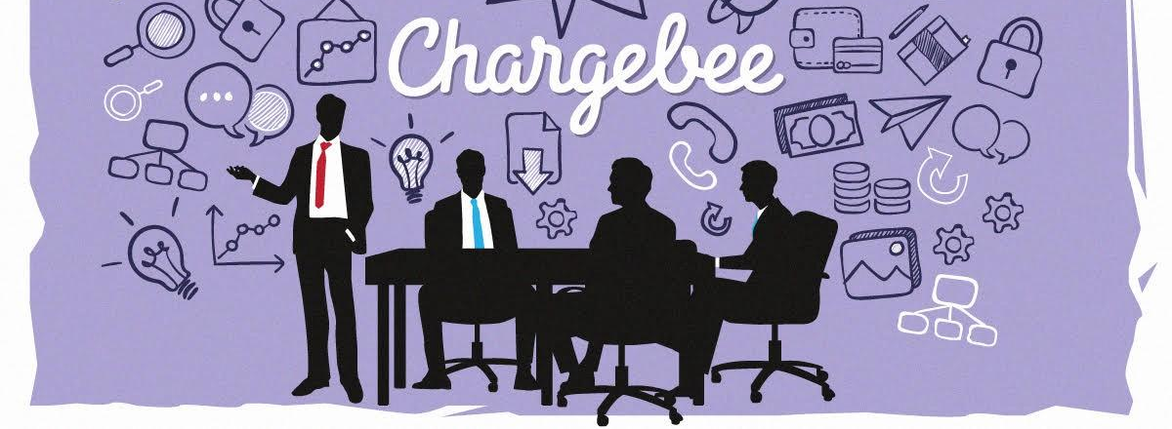
[ Team Using : Account Management / Care ]

Slide 18
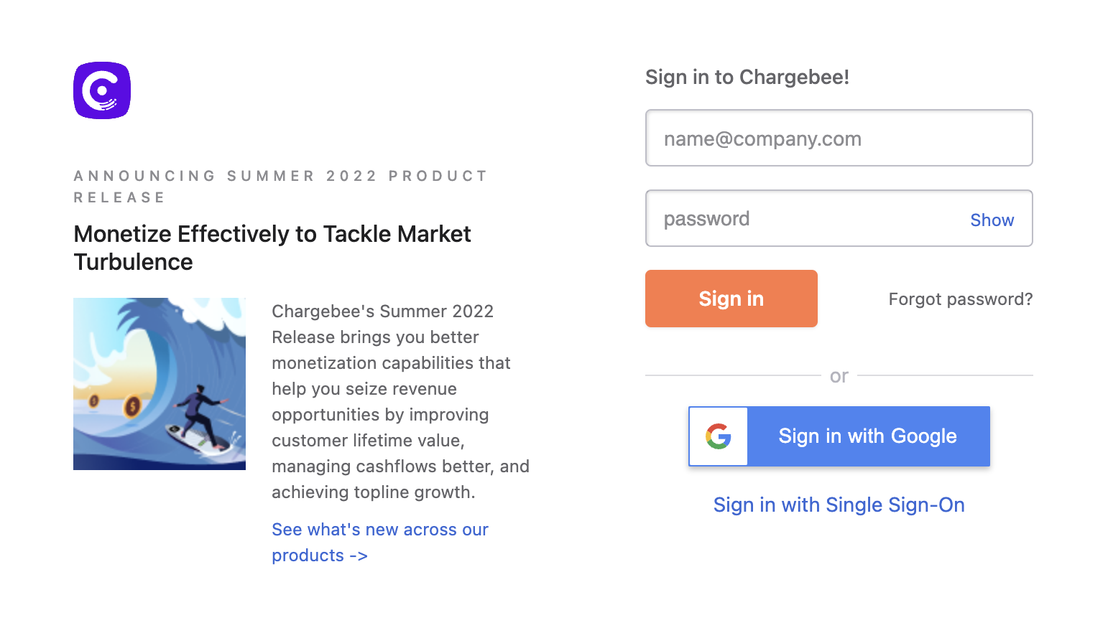
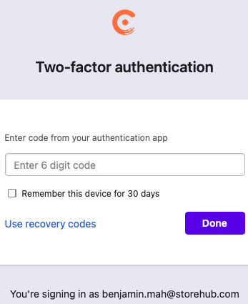
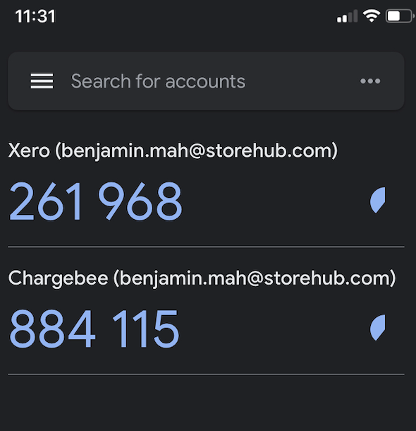
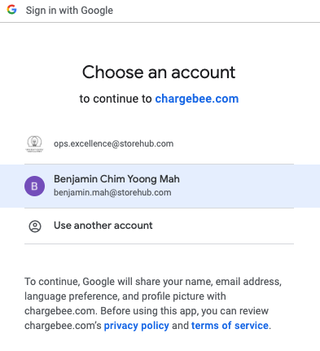
Chargebee
Login
https://app.chargebee.com/
Verify authentication by downloading Google Authenticator app
Once added, key in the same 6 digit code in the web page
Sign in with Google account
App = Application

Slide 19
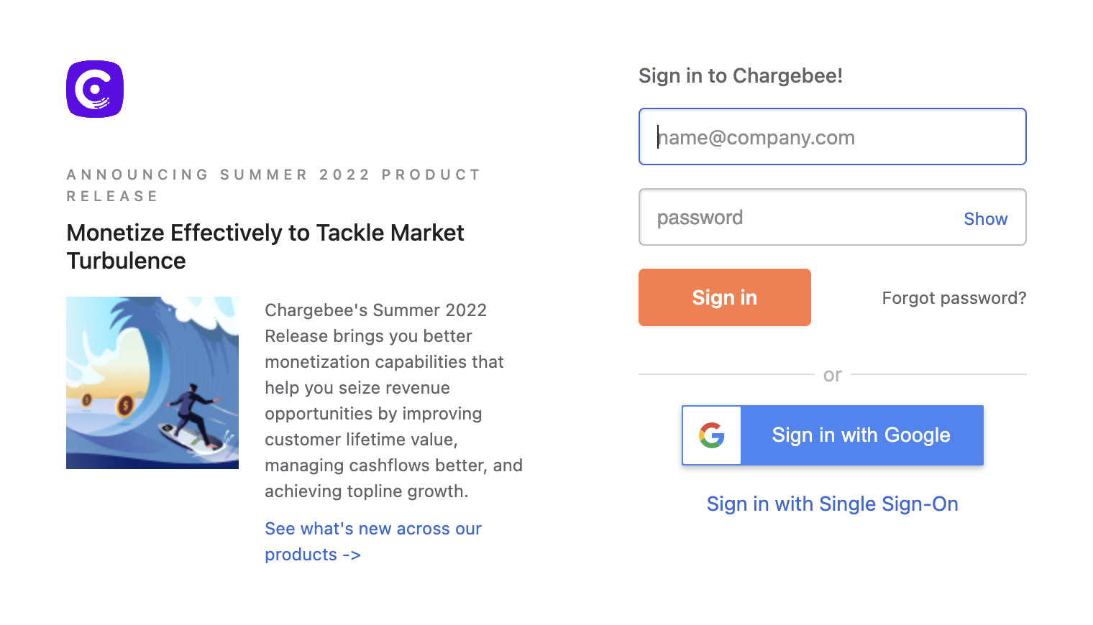
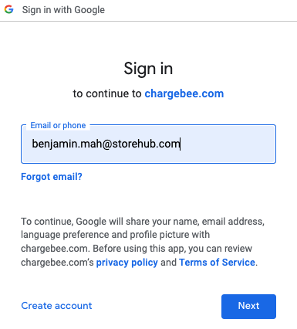
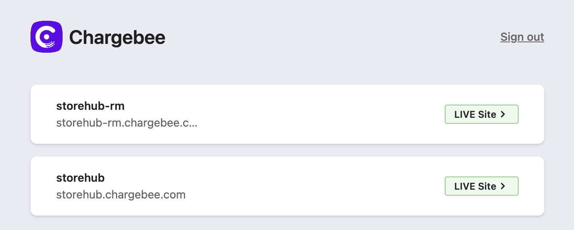
Chargebee
Introduction
https://app.chargebee.com/
Functions
View merchant’s subscription details
Edit merchant’s subscription
Mainly used by:
Account Management Team
Care Team
storehub-rm.chargebee.com
[Malaysian accounts only]
storehub.chargebee.com
[All accounts except Malaysian account]

Slide 20
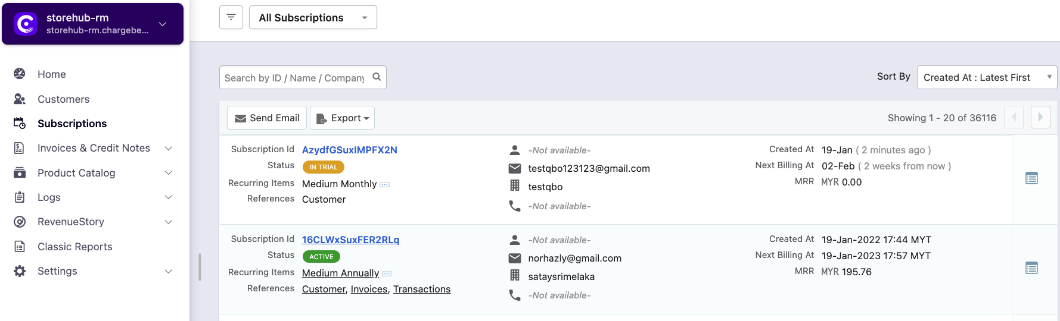
Chargebee
Navigation
Customers
Subscriptions
View contact information of merchant
Limited information on merchant subscription details
Merchant’s detailed subscription information
View charges and payment information of subscription

Slide 21
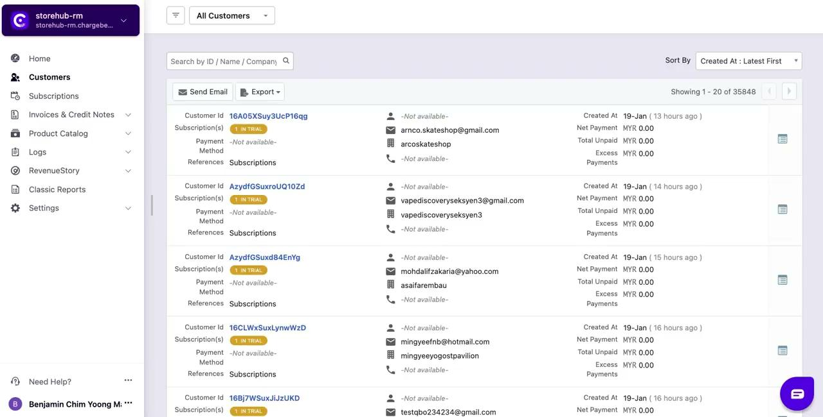
Chargebee
Navigation - Video

Slide 22
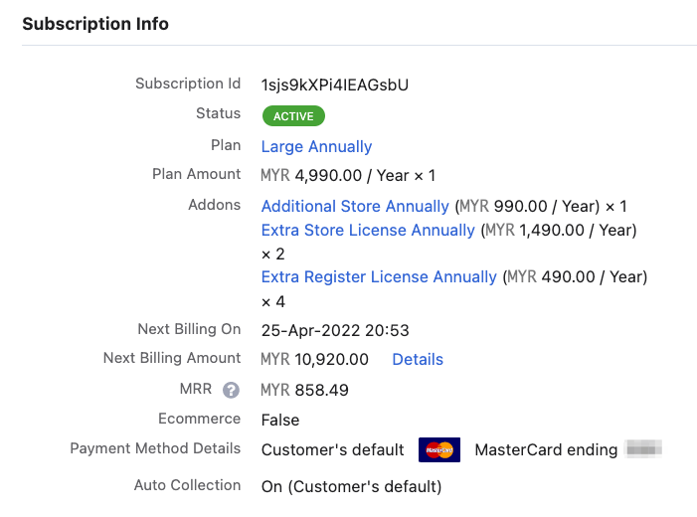
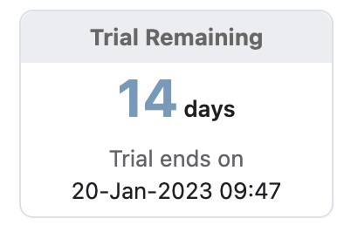



Chargebee
Subscription Details
Active
Merchant’s plan is still active
Cancelled
Merchant cancelled their plan
In Trial
Merchant recently register with StoreHub
Merchant Subscription Plan (Annually / Monthly)
Small: Starter Plan
Medium: Advance Plan
Large: Pro Plan
Base Plan: Base Plan
Additional Store [Extra store license]
Country | Pricing (Yearly)
 | MYR 1,490
 | PHP 490
 | THB 12,500
Additional Register [Extra POS terminal in existing store]
Country | Pricing (Yearly)
 | MYR 490
 | PHP 190
 | THB 6,000
SH = StoreHub

Slide 23
Chargebee
Subscription Details
Next Billing On
When will SH charge
Next Billing Amount
Total Charges
MRR
Monthly Recurring Revenue
Payment Method
Card: Auto charge / Auto debit
Blank: Manual payment
SH = StoreHub

Slide 24
Intercom

Slide 25
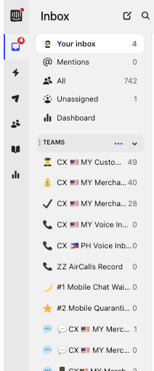
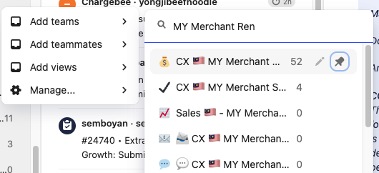
Intercom
Team Search
When to use?
When players wish to locate team and retrieve conversations
Team Search
On the Intercom ‘Inbox’ tab, search for ‘Teams’ option
Hover cursor over to 3 dots button and click on it
Select ‘Add teams’ then type and search for “CX 🇲🇾 MY Merchant Renewal”

Slide 26
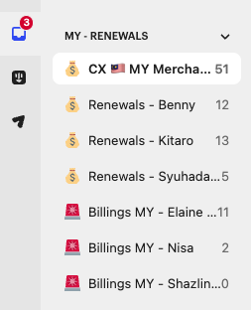
Intercom
Onboarding (ONB Team View)
When to use?
When players wish to check their own bucket or specific teammates’ bucket
ONB Team View
On the Intercom ‘Inbox’ tab, search for ‘ONB Team View’ Option
Select the desired OE/OC’s name
OE = Onboarding Executive | OC = Onboarding Consultant

Slide 27
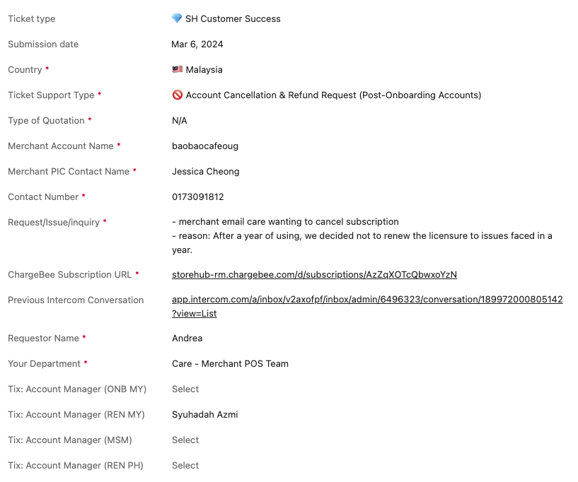
Intercom
Conversation Type
Account Cancellation & Refund Request
i) Cancelling the account at the end of their subscription.
ii) Request to unbind device while account is active.
Example Ticket here

Slide 28
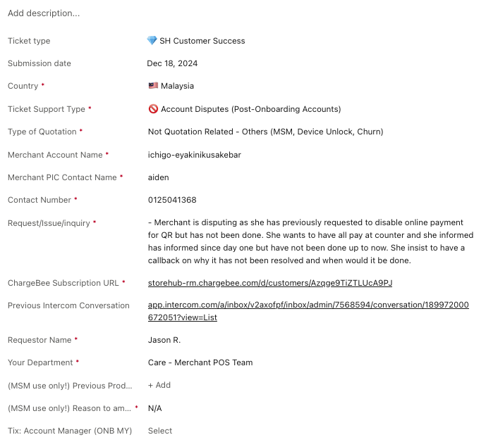
Intercom
Conversation Type
🚫 Account Disputes (Post-Onboarding Accounts)
i) Disputing due to dissatisfaction with service with proof of communications.
ii) Disputing due to mishandled expectations of our products with proof of communications.
iii) Disputing on overpayments on renewals with proof.
Example Ticket here

Slide 29
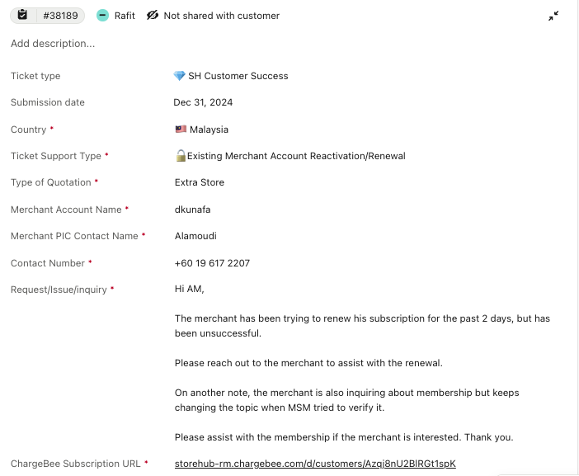
Intercom
Conversation Type
🔓Existing Merchant Account Reactivation/Renewal
i) Merchant wants to discuss / negotiate on renewals
ii) Merchant wants to reactivate their account
iii) Temporary reactivation to obtain sales data
Example Ticket here

Slide 30
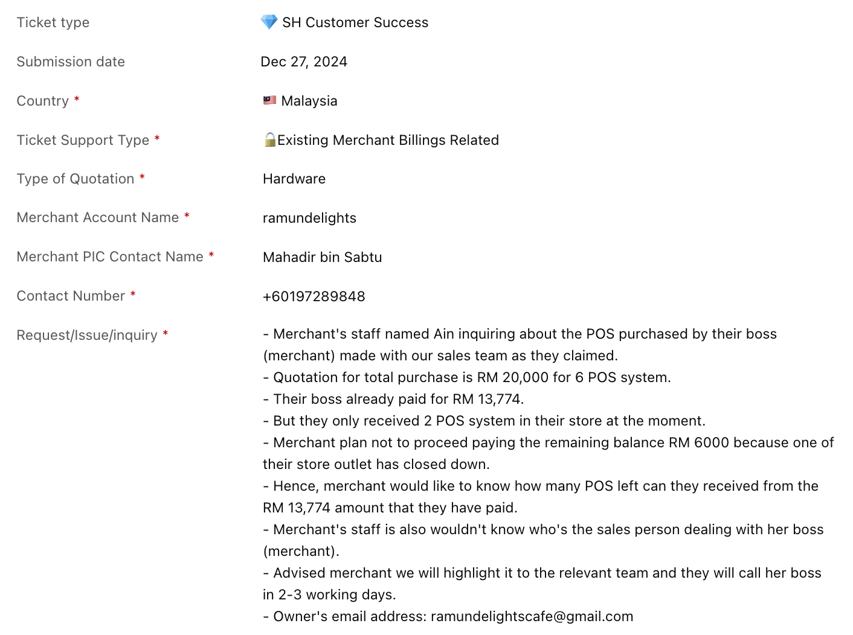
Intercom
Conversation Type
🔓 Existing Merchant Billings Related
i) Merchant wants to amend details on their accounts.
ii) Merchant wants to have their past years invoices.
iii) Merging accounts (possible but must understand why)
iv) Change account name (possible but must understand why)
Example Ticket here

Slide 31
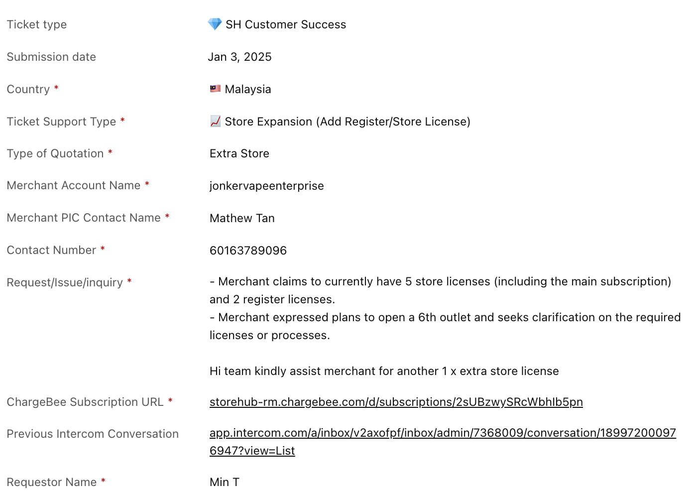
Intercom
Conversation Type
📈 Store Expansion (Add Register/Store License)
i) Existing merchant requesting to open a new account for their expansion. (AM)
ii) Existing merchant referring a friend who wants to open an account. (Sales)
iii) Non-merchant who wants to open an account. (Sales)
Example Ticket here

Slide 32
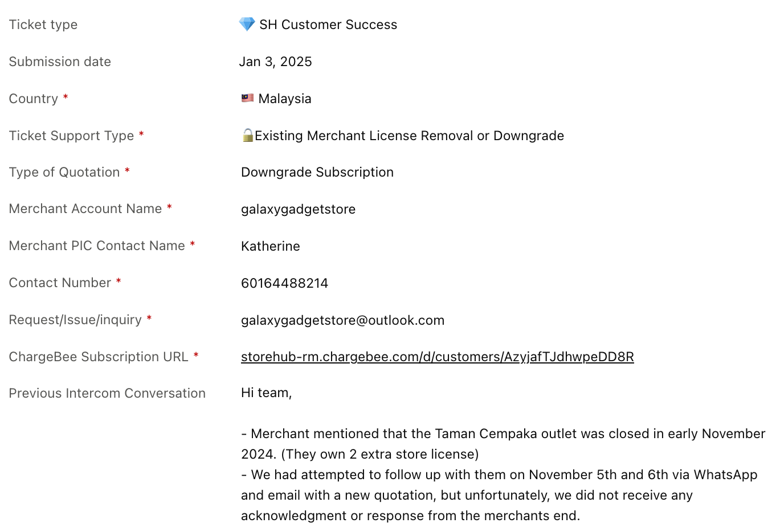
Intercom
Conversation Type
🔓 Existing Merchant License Removal or Downgrade
i) Requesting to downgrade from Pro to Advanced Plan.
ii) Requesting to downgrade from Advanced to Starter Plan.
iii) Requesting to remove additional store license upon renewal.
iv) Requesting to remove engage upon renewal.
Example Ticket here

Slide 33
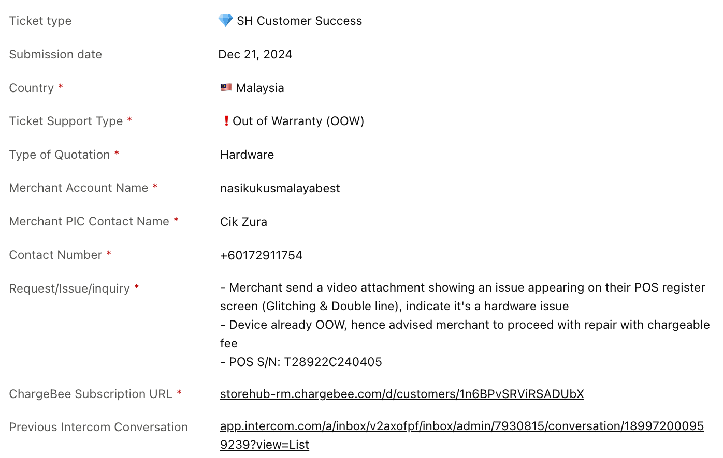
Intercom
Conversation Type
❗ Out of Warranty (OOW)
i) Outdated hardware that can't be troubleshooted.
ii) Relatively new hardware that has recently past warranty period.
Example Ticket here

Slide 34
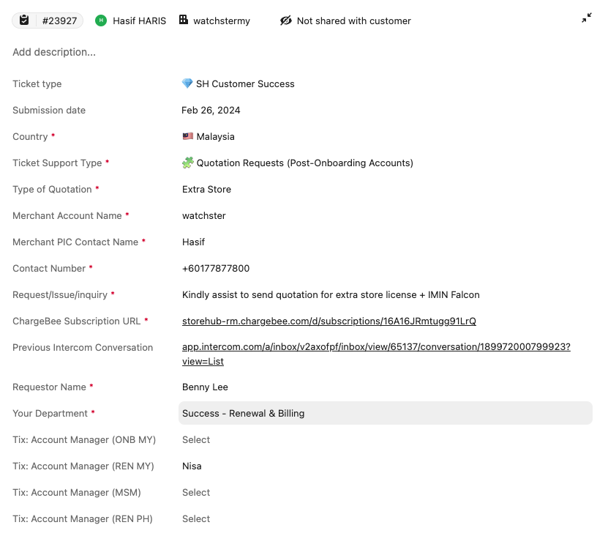
Intercom
Conversation Type
Quotation Requests (Post-Onboarding Accounts)
When merchant requests for an upgrade/additional purchases, AM will send a ticket to BE to create quotation.
Example Ticket here
Refer to the process flow here

Slide 35
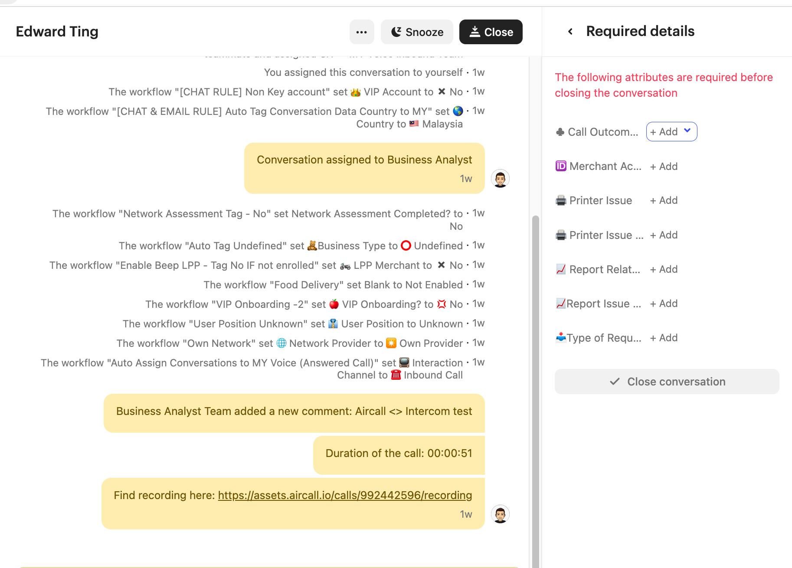
Intercom
Close Conversation
Important Notes
Close the conversation when the issue is resolved/no follow up/no reply is required
Fill up required information before closing the conversation

Slide 36

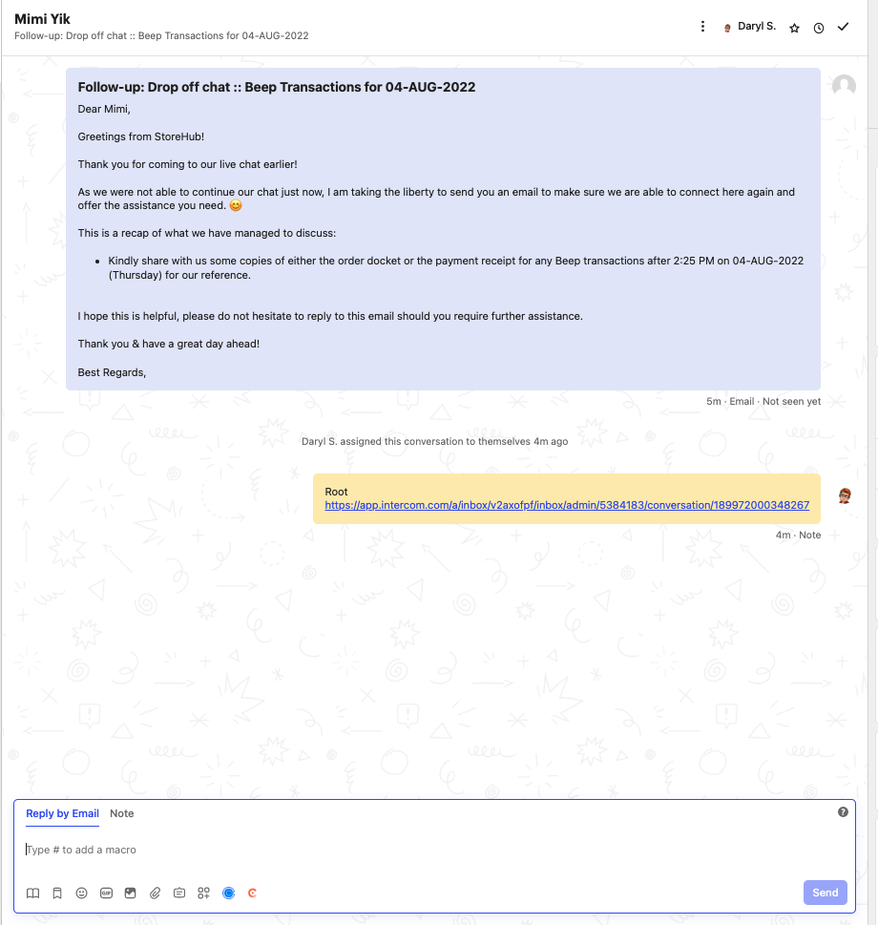

Email
Handling Inbound Email
Email is auto assigned to player
Player unable to choose their customer
Email Layout

Slide 37
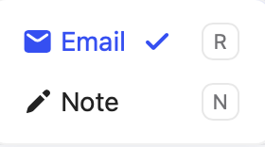
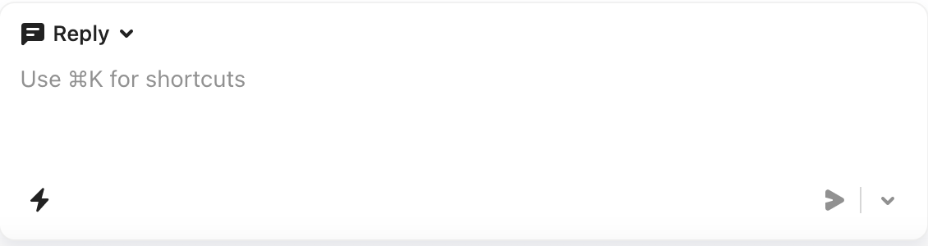
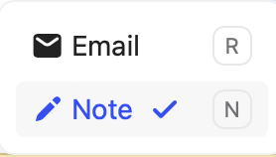

Email
Reply vs. Note
Reply
Player reply to customer tickets by adding contents
Internal Note
Player leave internal note for the case (It is not visible to merchant / customer view)

Slide 38





Email
Macro (cont.)
Methods 2: How to use Macro
Click ”...” icon
Select the correct macro on the popup box
Player need to check the macro before sending out to customer

Slide 39



Email
Close Conversation
Important Notes
In order to close the conversation, tagging on all required details (attributes) is a MUST.

Slide 40

Basic Functions

Slide 41




Basic Functions
Assign to Team / Teammate
Assign to Teammate
Manually assign a conversation to a specific teammate, the team assignment also remains in place
Assign to Team
Assigning a conversation to a team will remove the teammate assignment, so it can be picked up from that team’s inbox at the right time

Slide 42


Basic Functions
Snooze Conversation
Important Notes
If follow up is required, player can opt to snooze the conversation and set specific time.
It will reopen automatically when set specific time ends.
Player need to reply the conversation within the promised time given to the merchant / consumer.

Slide 43


Basic Functions
Ticket Escalation (Create New Ticket)
Ticket Creation
Select the relevant ticket to be created
When to use?
When issue requires other team (Account Management, Onboarding, MSM, Care) to follow up. Inform merchant to expect contact within 2 working days. (E.G: Renewal, Activation, Onboarding)
OB = Outbound

Slide 44

Basic Functions
Ticket Escalation (Cont.)
Care Inbound Call & Live Chat team to use for scheduled follow up outbound call to merchant
Escalation from Care T1 > MSM for Beep QR & Delivery Leads
Escalation from Care T1 > MSM for Food Delivery Integration requests
Escalation from Other department > Care T1 for Hardware/Software/BackOffice troubleshooting requests
Escalation from Care T1 > T2 for Hardware related issues
Escalation from Care T1 > T2 for Mall Integration related issues
Escalation from Care T1 > T2 for software related issues
Escalation from Care > Onboarding/Account Management for account/onboarding related requests
OB = Outbound

Slide 45



Basic Functions
New user Lead Submission
When caller gets connected through with ONB players but require sales inquiry
Notes:
Important note: Phone number MUST be added with correct country code “+60” & “+63” to standardize mapping between SF and Intercom

Slide 46
Aircall

Slide 47



Aircall
Download Aircall
Open Apple Apps Store on your Macbook
Search “Aircall” on the search bar

Slide 48

Aircall
Download Aircall (cont.)
Click “GET” to download Aircall on your Macbook

Slide 49


Aircall
Inbound Call
Button | Function
 | Mute agent’s microphone
 | Put customer on hold
 | Input Number
 | Adding notes for your call (synced to Intercom conversation)
 | Categorize your call activity for reporting
 | Assign your teammate for follow up
 | Consult or Conference call
 | Transfer call to other player
 | End call
Contact details will be available
You may use phone functionality during call

Slide 50



Aircall
Agents Don'ts
Do NOT change working hours.
It should always stay 9am - 6pm, (Unless told otherwise)
Do NOT change Wrap-up time, It should always stay 1 min
(Unless told otherwise)
Do NOT change status to “Unavailable” unless going for break, meal or TL consultation. Request permission from TL before doing so

Slide 52



Metabase
Metabase
Functions
1. To review merchant’s business health sentiment.
2. To view transactions for Qr Order and Pay and Beep Delivery.
3. Helps to identify potential in merchants business.

Slide 53

Metabase
Metabase - Video

Slide 54


Supply Chain
[ Team Using : Supply / Care ]

Slide 55




Supply Chain
Overview
Introduction
Salesforce
Oracle Netsuite
Delivery Issue

Slide 56


Supply Chain
Introduction
Look out for latest announcements on updates related to:
Supply Chain: Hardware related updates
Business Process: Work process updates
Workplace: CPM Announcement
Click Like for acknowledgement or post question related on the topic posted by the CPM Team

Slide 57






Supply Chain
Introduction
Vendors Used

Slide 58

Supply Chain
Oracle Netsuite
Dashboard

Slide 59
Supply Chain
Quotation & Order Creation
Salesforce
Netsuite
Create Quote
Email Quote & follow up payment
Create Order
Attach Payment Slip
Sales / Success
Approve and activate order
Sync into Netsuite Sales Order
Finance
Update Netsuite Memo as Software / Hardware / Software + Hardware
Close SO
Generate invoice and send to merchant
Process SO & Arrange Hardware Delivery.
The delivery details (tracking link or number) will be synced into SF through integration on daily basis (Salesforce x Vendor Gsheet Integration)
Supply Chain
SO = Sales Order

Slide 60


Supply Chain
Tracking Number in Salesforce
Use Salesforce to search for Supply Chain information such as
Transport Type
Tracking Number / Tracking Link
Delivery Status & Timestamp
SalesForce order dashboard - Here

Slide 61
Supply Chain
Hardware Delivery
Hardware Delivery SLA
Within Klang Valley: Delivery Provider: Lalamove (Default) Same day between 3.00pm - 5.00pm | Outside Klang Valley: Delivery Provider: GDEX Peninsular: Between 3 - 5 days East Malaysia: Between 5 - 7 days
Onsite Service SLA
Case / Ticket creation in Tracking: Cut-off time is 12.00pm daily Tier 2 will contact merchant within 1-2 working days to arrange for visit.
State | Portal Request Date (by StoreHub) | Appointment Contact Day By Engineer (working day) | Target Engineer Appointment Date (Depending on agreed Date)
Selangor / KL | Wednesday before 12.00pm | Thursday (next day) | Friday
 | Wednesday after 12.00pm | Friday (day after next) | Monday
Kelantan / Terengganu / Kedah (Weekend: Friday & Saturday) | Wednesday before 12.00pm | Thursday (next day) | Sunday
 | Wednesday after 12.00pm | Sunday (day after next) | Monday
SLA = Service Level Agreement

Slide 62

Supply Chain
Escalation Flow for Hardware Delivery
Merchant’s Responsibility:
Check all items delivered
Check physical condition of goods delivered
Take clear picture of parcel / item if damaged
Malaysia
Damaged Parcel / Missing Item | Defective Unit
Within 1 working day of receiving Parcel | Within 14 days of receiving parcel
Contact Salesperson/ Success:
Raise ticket to Supply Chain by sending email to care@storehub.com
Contact Merchant Care Team:
Merchant Care team to raise internal note with @businesssupport
SurfsTek & iMin MAY NOT entertain if report is given past 3 working days
If there are any issues, Merchant to take all the evidence, keep all original packaging and content for the reverse pick-up.

Slide 63


The Platform for Awesome Businesses
The End
THIS DOCUMENT IS STRICTLY PRIVATE AND CONFIDENTIAL. THIS IS INTENDED FOR INTERNAL USE ONLY; DO NOT CIRCULATE
Copyright © 2022 StoreHub. All rights reserved. No parts of this document can be reproduced, distributed, transmitted or stored electronically without StoreHub’s prior written permission.
21

